Slide 1

Hospital Management System
OOTs Using JAVA (BCSE0352)
Department of Computer Science and Engineering
Data Science
(Submitted To: Mr. Chandrapal Singh Arya)
Group Members
Name of Member | Roll Number | Role | Department n Section
KASHIF HUSSAIN | 2401331540136 | System Architecture & Backend Development | Data Science Sec-B
GAURAV GUPTA | 2401331540115 | Database Management & Documentation | Data Science Sec-B
DEENDAYAL | 2401331540097 | Frontend Design & GUI Development | Data Science Sec-B

Slide 2

Index
Introduction
Literature Survey/Existing System
Problem Statement
Proposed Methodology
Flowcharts and Use Case/ER Diagrams
Feasibility Study
Hardware /Software Requirement
Live Demonstration of Project with screenshots in ppt
Results and Conclusion
Future Enhancement
References

Slide 3

Introduction
Overview:
  Java-based desktop app using Swing GUI
  Manages hospital operations digitally
  Modules for patients, doctors, billing & more
Objectives:
  Digitalize hospital records
  Automate appointments & billing
  Simplify prescriptions
  Enhance data security
  Improve efficiency & patient care
Scope:
Suitable for hospitals, clinics, healthcare centers
Covers:
• Patient Management
• Doctor Management
• Appointments
• Prescriptions
• Billing
Key Highlights:
User-friendly interface
Real-time data handling
Dashboard with live stats
Secure & reliable operations

Slide 4

Literature Survey
Overview:
  Study of existing hospital management systems.
  Identifies gaps and improvement areas.
Existing Systems Observed:
  Manual record keeping is still common.
  Poor integration between patient and billing modules.
  Limited user-friendly designs.
  Weak data security in many systems.
Findings:
  Need for a unified, digital hospital system.
  Should include appointment, prescription & billing modules.
  Must ensure fast access and strong data security.
Conclusion:
  Ojasvi Hospital Management System aims to fill these gaps by offering an integrated, secure, and efficient solution.

Slide 5
Problem Statement
Current Scenario
  Most hospitals still use manual systems for record-keeping.
  Managing patient data, doctor schedules, and billing is time-consuming.
  Errors often occur due to paper-based entries and data duplication.
  Lack of integration between departments causes delays and inefficiency.
  Difficulty in retrieving past records and maintaining data security.
Identified Problems
  ❌ Inefficient and slow hospital operations.
  ❌ Poor coordination between patients, doctors, and staff.
  ❌ High chances of data loss or inconsistency.
  ❌ Manual billing and prescription handling cause confusion.
  ❌ Limited accessibility of patient information.
Goal:
To design a digital, secure, and integrated Hospital Management System that automates all major hospital operations and improves overall efficiency.

Slide 6
Proposed Methodology
System Design Approach
  The system is developed using Java Swing for GUI and File Handling / Database (if added) for data storage.
  Follows Object-Oriented Programming (OOP) principles for modularity.
  Each module (Patient, Doctor, Appointment, Billing) is designed as a separate class for better structure.
  Implements Event Handling for all user actions (buttons, menus, etc.).
  Emphasizes user-friendly navigation and clean UI design.
💡 Highlights
  Modular, Reusable, and Scalable structure
  GUI-based user interaction
  Fast and secure data processing
Development Phases
Requirement Analysis:🧠
  Identified hospital management needs and core features.
System Design:🧩
  Created interface layouts and module flow diagrams.
Implementation:💻
  Developed using Java, Swing, and OOP concepts.
Testing:🧪
  Verified functionality of each module and removed errors.
Deployment:🚀
  Final application ready for hospital or clinic use.

Slide 7
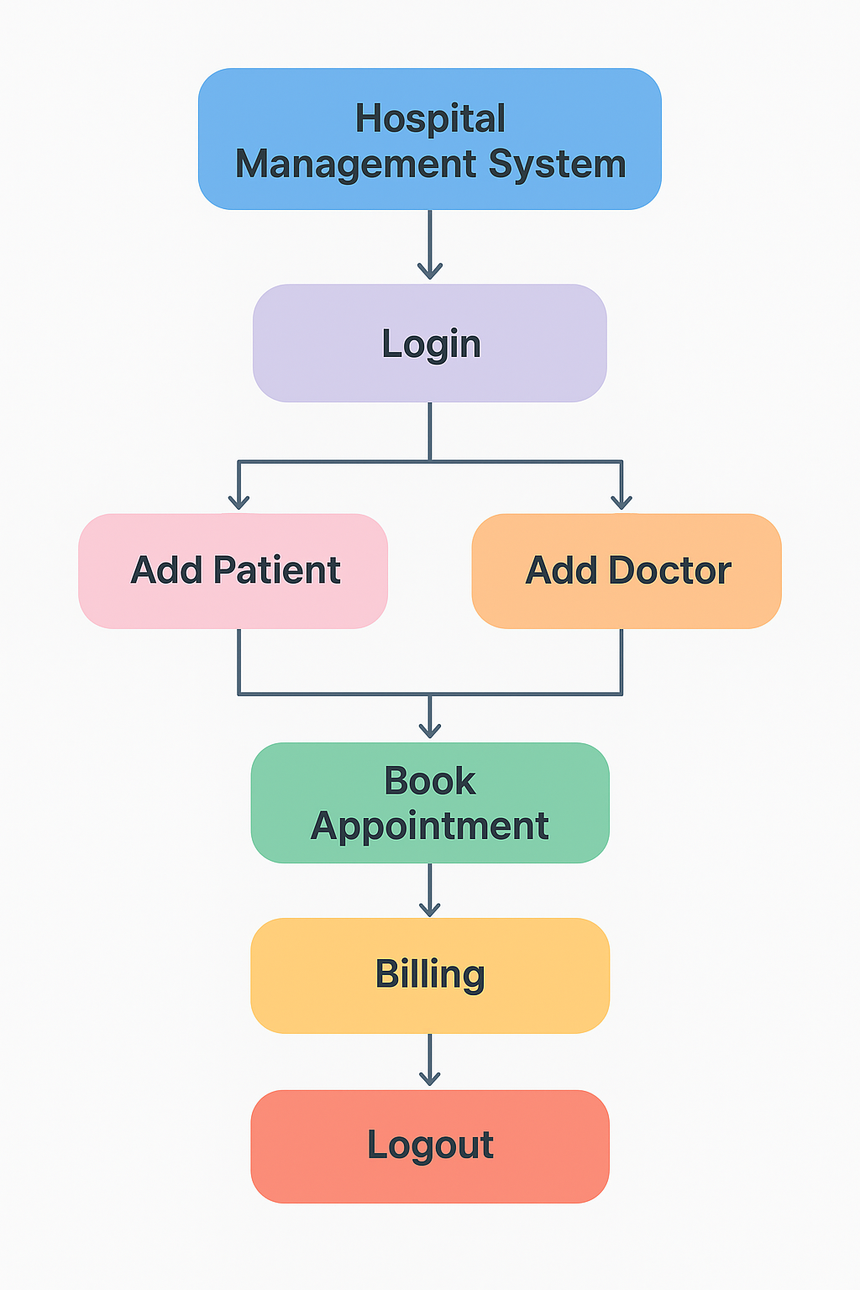
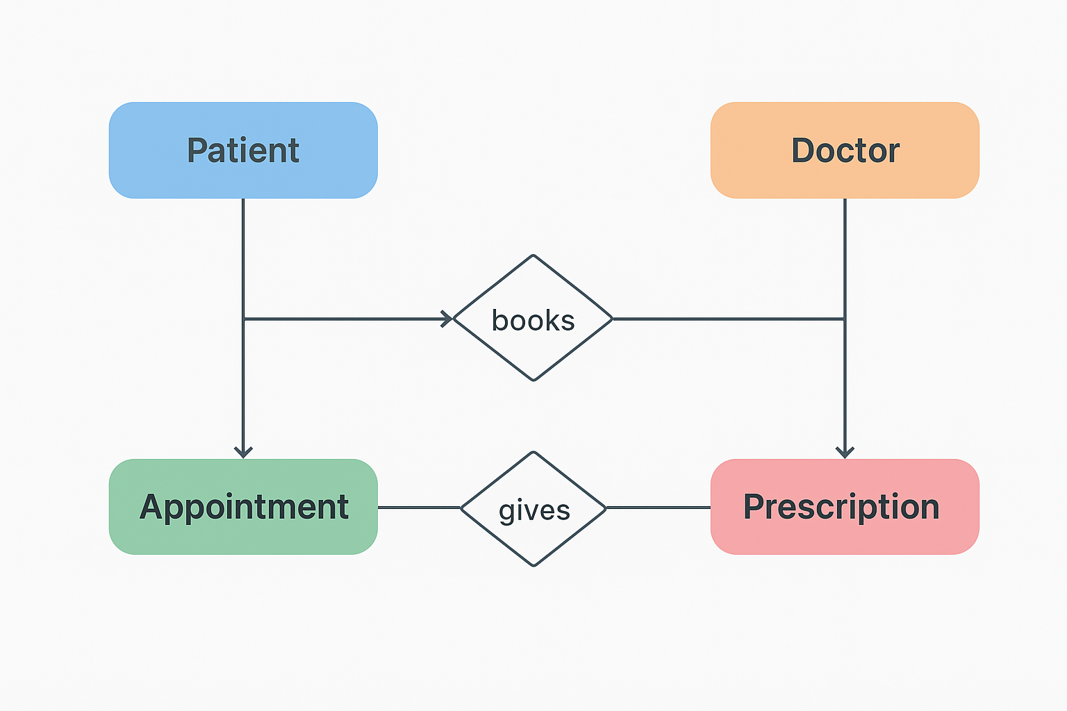
Flowchart and ER Diagrams

Slide 8
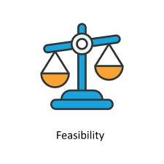
Feasibility Study
1️⃣ Technical Feasibility:
  Developed using Java Swing for GUI and OOP concepts for logic.
  Compatible with all major operating systems.
  Requires only a basic computer system with Java installed.
2️⃣ Operational Feasibility:
  Simplifies hospital tasks through easy navigation.
  Reduces manual effort and human errors.
  Improves communication between doctors, staff, and patients.
3️⃣ Economic Feasibility:
  Cost-effective as it uses open-source tools (Java).
  Reduces long-term cost of paperwork and data management.
4️⃣ Time Feasibility:
  Fast development cycle using modular structure.
  Can be implemented in a short time frame with future scalability.
5️⃣ Social Feasibility:
  Enhances hospital services, benefiting patients and staff.
  Promotes digital adoption and environment-friendly operations.

Slide 9
System Requirements
Hardware Requirements
  Processor: Intel Core i3 or above
  RAM: Minimum 4 GB (Recommended 8 GB)
  Storage: 500 MB free space (for application & files)
  Display: 1366×768 resolution or higher
  Input Devices: Keyboard & Mouse
  Operating System: Windows / macOS / Linux
Software Requirements
  Programming Language: Java (JDK 8 or above)
  IDE Used: NetBeans / Eclipse / IntelliJ IDEA
  Libraries & Tools:
    Java Swing (for GUI)
    FlatLaf (for modern UI design)
  Database (optional): MySQL / File Handling
  Platform: Java Virtual Machine (JVM)
  Documentation Tool: MS Word / Google Docs
💡 Note:
The project runs efficiently on any standard laptop or desktop with Java installed and does not require high-end hardware.

Slide 10
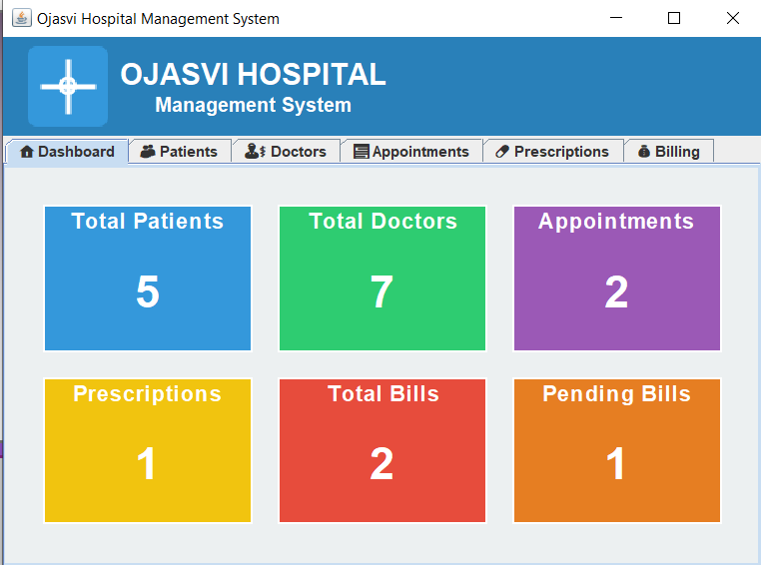
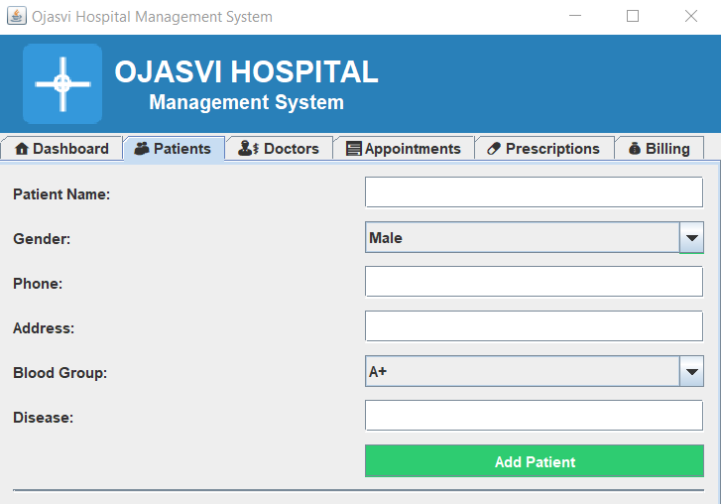
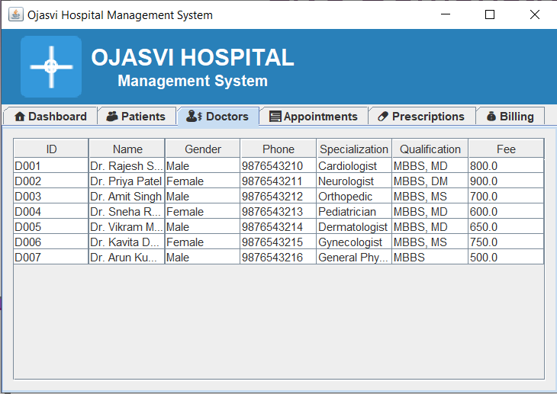
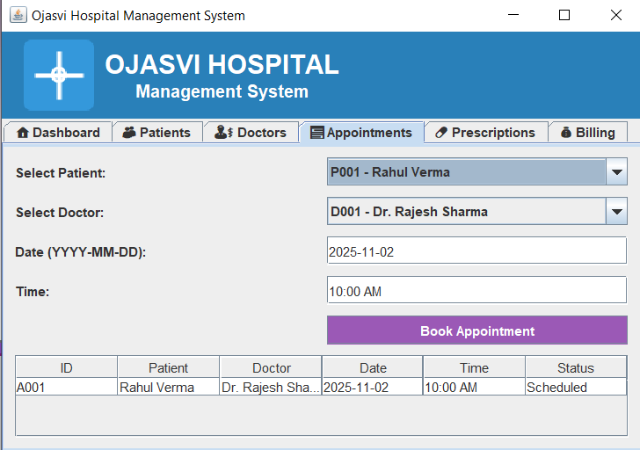
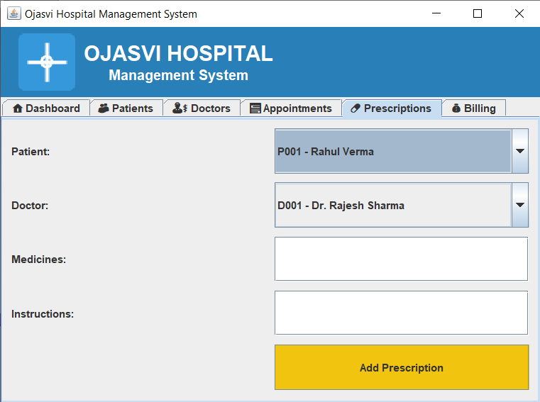
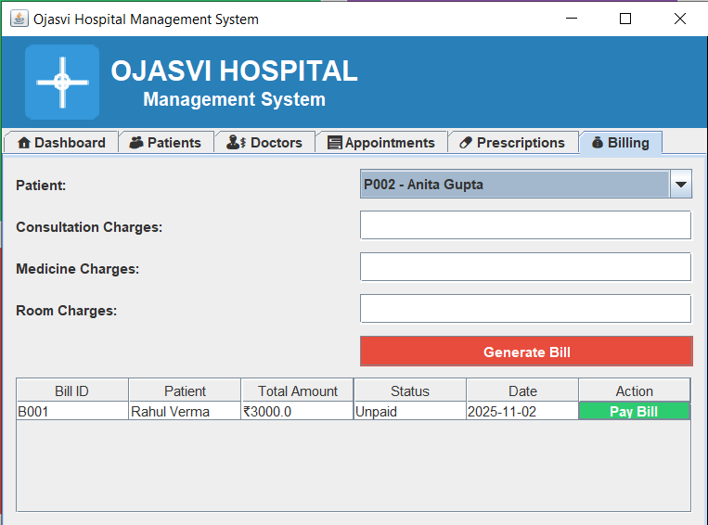
Live Demonstration

Slide 11
Result and Conclusion
💻 Results
  Successfully developed a Java-based Hospital Management System using Swing GUI.
  Implemented modules for Patients, Doctors, Appointments, Prescriptions, and Billing.
  The system provides a user-friendly interface and real-time data handling.
  Ensures secure storage and quick access to hospital records.
  Demonstrates the application of Object-Oriented Programming (OOP) concepts effectively.
🎯Conclusion
  The project achieves its goal of automating hospital operations and minimizing manual effort.
  It improves efficiency, accuracy, and data security in hospital management.
  The system can be expanded in the future with database integration, reporting tools, and cloud connectivity.
  Overall, it provides a reliable, efficient, and scalable solution for modern healthcare management.

Slide 12
Future Enhancement
💻System Improvements Integrate a centralized database (MySQL / Oracle) for secure data storage. Add cloud support for online hospital access from any location. Implement role-based login for Admin, Doctor, and Receptionist. Introduce automated report generation (patient history, revenue, etc.). | 🤖Advanced Features Develop a mobile application for patients and doctors. Add email/SMS notifications for appointments and billing. Integrate AI-based diagnosis suggestions for doctors. Enable online payment gateways for billing and fees. Add data analytics and dashboards for performance tracking. | 📊Long-Term Vision Transform into a complete digital hospital ecosystem. Enable multi-branch hospital management under one system. Ensure real-time synchronization between hospital departments.

Slide 13

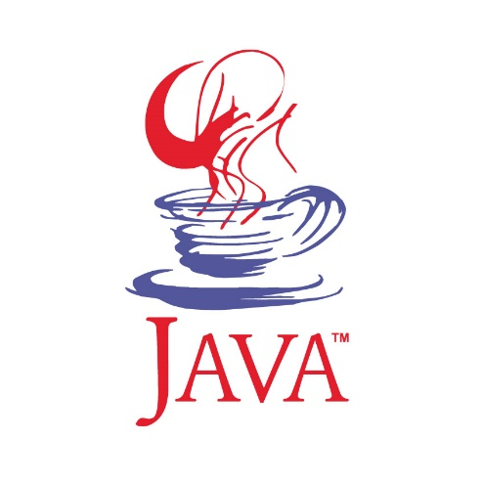

References
Java: The Complete Reference – Herbert Schildt
Object-Oriented Programming with Java – E. Balagurusamy
W3Schools – Java Tutorials
GeeksforGeeks – Java & Swing Examples
Oracle Java Documentation

Slide 14
Thank You

